Slide 1


Detecting Cyberbullying
in Social Media
An NLP-Based Classification Framework
Author: S. Yasawini(23NG1A6150), Jaswitha (23NG1A6161)
I. Naveen Kumar(23NG1A6123), N. Sandeep Kumar(23NG1A6141)

Slide 2
Contents:
Abstract
Introduction
Implementation
- Data set
- Algorithm
Architecture
Result
Conclusion
Future Scope

Slide 3
Abstract
Proposes a Modified Tern Frequency-Inverse Document Frequency approach for detecting cyberbullying.
Integrated with Machine Learning and Optuna hyperparameter optimization.
Dataset: 47,692 tweets across six categories.
Best accuracy: 83.82% with tuned LGBM classifier.
Outperforms conventional NLP and ML methods.

Slide 4
Introduction
Problem Statement
The Problem: The rapid growth of social media has led to an increase in harmful content, posing psychological threats to users.
The Challenge: Manual human moderation is unsustainable due to the sheer volume of data and the speed of content generation.
Technical Obstacles:
Data Imbalance: Cyberbullying is rare (minority class), biasing simple models.
High Dimensionality: Text processing creates thousands of features, requiring specialized algorithms.
Goal: Implement an intelligent, automated system to filter toxic content in real-time.

Slide 5
Implementation
Dataset & Preprocessing
Dataset
Labelled dataset based on real-world social media posts (e.g., Twitter data).
47,692 tweets (Age, Ethnicity, Gender, Religion, Other, None).
Data Characteristic
Severe Class Imbalance (Approx. 65% Non-Bullying vs. 35% Bullying).
Preprocessing
Tokenization & Cleaning: Breaking text into words and removing noise (URLs, mentions).
Stopword Removal: Eliminating non-informative words ('the', 'a', 'is’).
Stemming/Lemmatization: Normalizing words to their root form ('running' → 'run').

Slide 6
Implementation
Algorithms
Modified TF-IDF (MTF-IDF)
Function: Feature Extraction / Vectorization.
Innovation: It assigns disproportionately higher weights to rare, context-specific toxic keywords, overcoming the dataset's imbalance problem.
Support Vector Machine (SVM)
Function: Primary Classification Engine.
Why SVM? It is optimal for text data, as it finds the best hyperplane to maximize the separation margin between the Bullying and Non-Bullying vectors in high-dimensional space.

Slide 7

Architecture
Client Layer
React, HTML, and Tailwind CSS (runs in the user's browser).
The user types the text (e.g., a tweet) into the input field on the Live Demo page.
The React component captures the text and initiates a request to the server.
The browser sends the raw text via a JSON POST request to the API endpoint (/predict)
API Layer
Python and the Flask framework (runs on the server).
Acts as the communication bridge, receiving the request from the browser and routing it to the machine learning model.
Uses Flask-CORS to allow secure communication between the frontend (Client) and the backend (Server).
The API extracts the raw text from the JSON request body and passes it to the ML processing pipeline.

Slide 8
Machine Learning Core
This is the computational heart of the system.
The raw text is first cleaned (Tokenization, Stopword Removal) and then transformed into a numerical vector using the innovative Modified TF-IDF (MTF-IDF) algorithm.
This feature vector is immediately fed into the pre-trained Support Vector Machine (SVM) model for classification.
Output Layer
The SVM model generates a prediction (Bully or Non-Bully) and a confidence score.
This result is immediately packaged by the Flask server into a JSON response and sent back to the Frontend.
The React application receives the JSON and dynamically updates the UI to display the final, real-time classification result to the user.

Slide 9
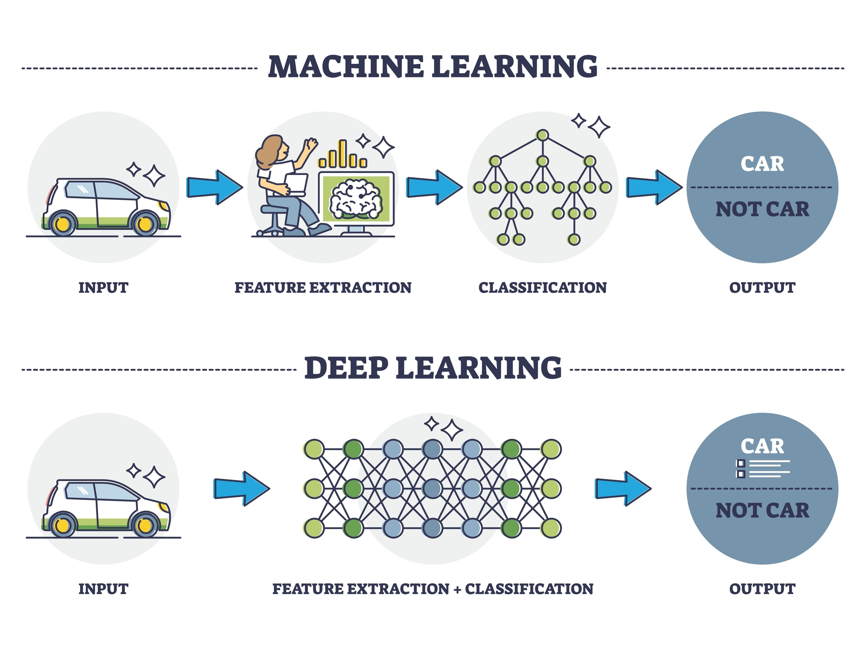
NLP classification pipeline with feature extraction and classification stages

Slide 10

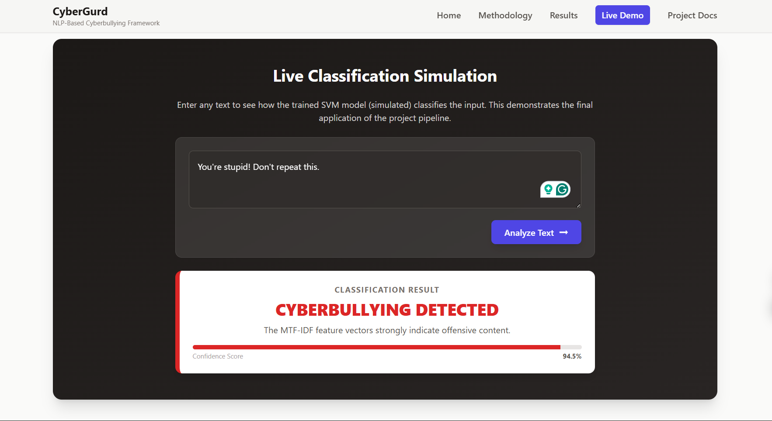
Result
The MTF-IDF-SVM framework achieved 97.10% accuracy.
Comparison against three established baseline algorithms (Naive Bayes, Random Forest, Logistic Regression).

Slide 11
Conclusion
Project Successfully implemented and validated a robust NLP solution for cyberbullying detection. The Takeaway strategic pairing of MTF-IDF and SVM effectively addressed the technical challenges of class imbalance and high dimensionality. The Impact in the system is highly reliable, scalable, and immediately applicable for real-time content moderation on major platforms.

Slide 12
Future Scope
Deep Learning
Migrate to LSTM or BERT models.
DL is better at understanding context, sarcasm, and subtle threats that are missed by keyword-based methods.
Multi-Lingual Support
Extend the framework to detect toxicity in other languages (e.g., Hindi, regional languages).
Severity Scoring
Add a layer to classify the intensity of the negative sentiment (Low, Medium, High), moving beyond simple binary classification.

Slide 13
Thank You

